Slide 1
Adaptative and Nonlinear Control
UAV Project

Slide 2
1. Model introduction

Slide 3
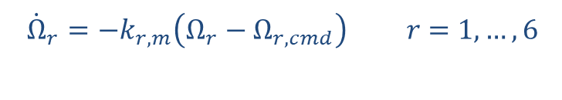


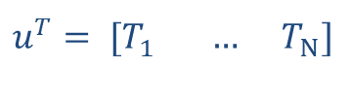

UAV Dynamics
Propeller Dynamics
Allocation
$$M{\dot{ν}}_{b}+ν_{b}^{×}Mν_{b}=−Dν_{b}+w_{g}+Fu$$
$${\dot{Ω}}_{r}=−k_{r,m}\left(Ω_{r}−Ω_{r,cmd}\right) r=1,…,6$$
$$\left(\begin{matrix}T_{c} \\ τ_{c}\end{matrix}\right)= Fu$$
$$u^{T}= [T_{1} … T_{N}]$$
$$T_{r}={\text{sat}}_{T_{m}}^{T_{M}}\left(λ_{r}k_{f}Ω_{r}^{2}\right)$$

Slide 4
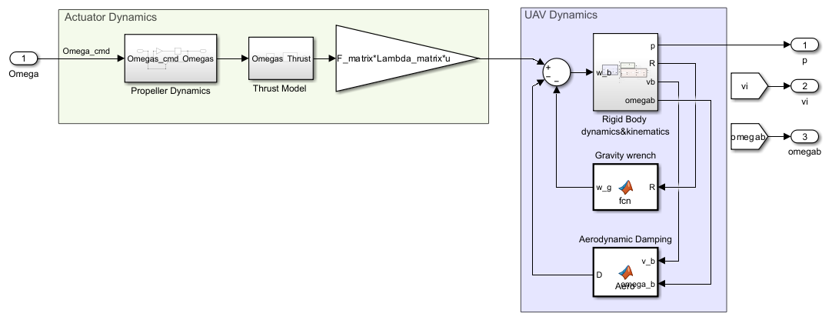
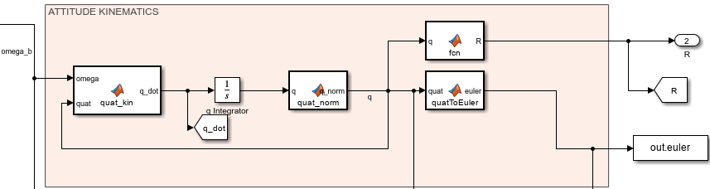
1.1. Simulink Model
Input
$$Λ ≡ control efectiveness$$
Outputs
Use of quaternions and rotation matrices to avoid Euler angles singularities

Slide 5
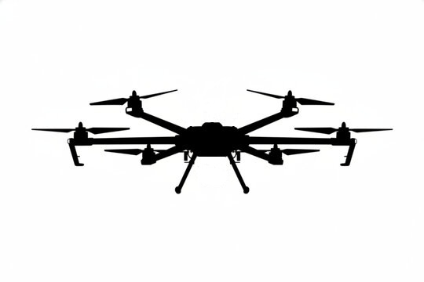
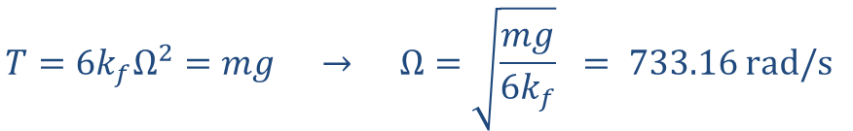
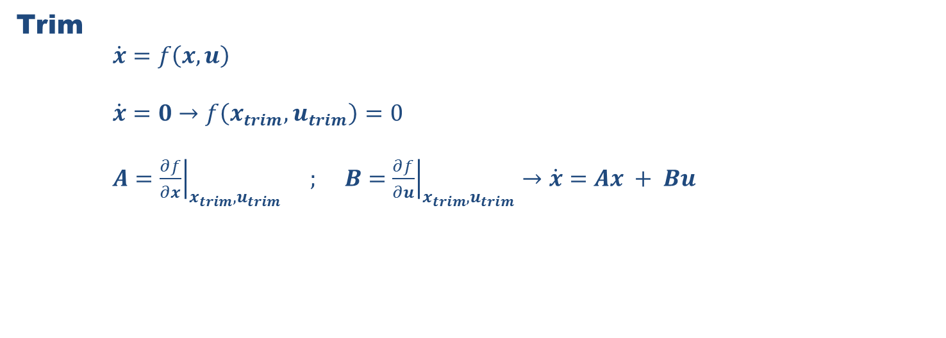
1.2. Model Trim
Static Position Trim
Trim
$\dot{x}=f\left(x,u\right)$
$\dot{x}=0→f\left(x_{trim},u_{trim}\right)=0$
$A={\left.\frac{∂f}{∂x}\right|}_{x_{trim},u_{trim}} ; B={\left.\frac{∂f}{∂u}\right|}_{x_{trim},u_{trim}}→\dot{x}=Ax + Bu$
T
Simple trim case
$$p={\left[0,0,1\right]}^{T} // v=ω_{b}=0$$
W
$$T=6k_{f}Ω^{2}=mg → Ω=\sqrt{\frac{mg}{6k_{f}}} = 733.16 rad/s$$

Slide 6

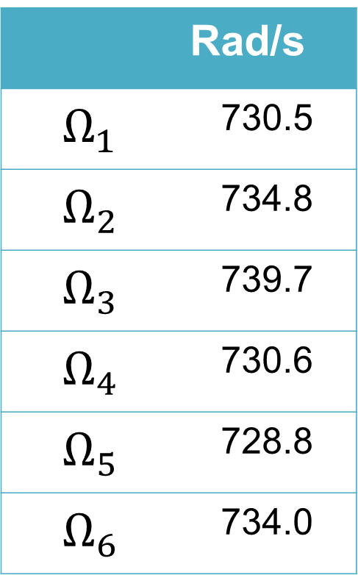
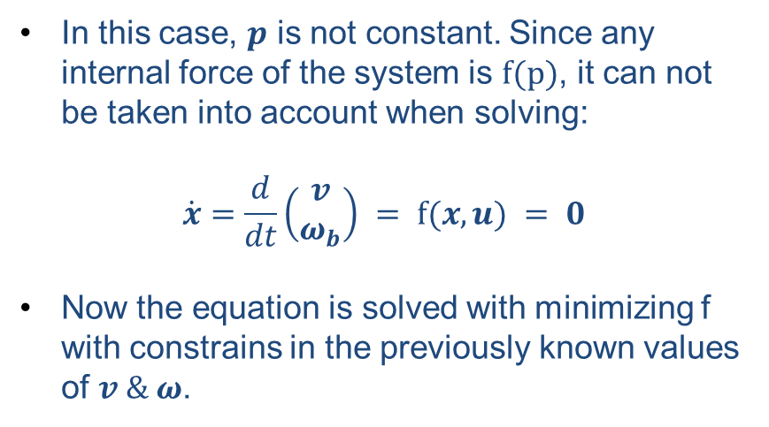

1.2. Model Trim Constant x velocity
 | Rad/s
$$Ω_{1}$$ | 730.5
$$Ω_{2}$$ | 734.8
$$Ω_{3}$$ | 739.7
$$Ω_{4}$$ | 730.6
$$Ω_{5}$$ | 728.8
$$Ω_{6}$$ | 734.0
$$v={\left[1,0,0\right]}^{T}//ω_{b}=0$$
T
In this case, $p$ is not constant. Since any internal force of the system is $f(p)$, it can not be taken into account when solving:
$$\dot{x}=\frac{d}{dt}\left(\begin{matrix}v \\ ω_{b}\end{matrix}\right) = f(x,u) = 0$$
Now the equation is solved with minimizing f with constrains in the previously known values of $v \& ω$.
$$Θ$$
v
D
W

Slide 7
2. Baseline controller implementation, tuning and testing

Slide 8
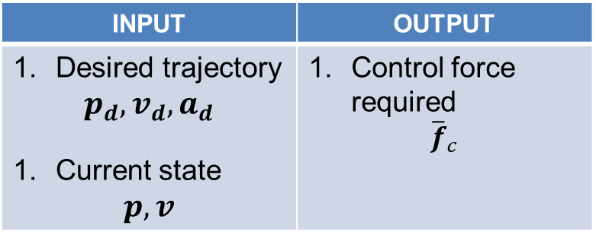
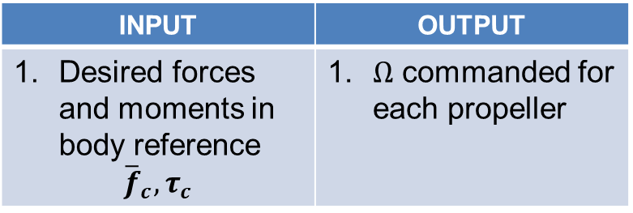
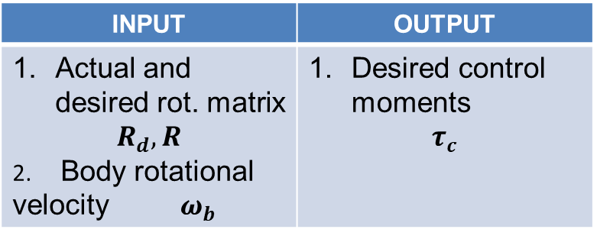
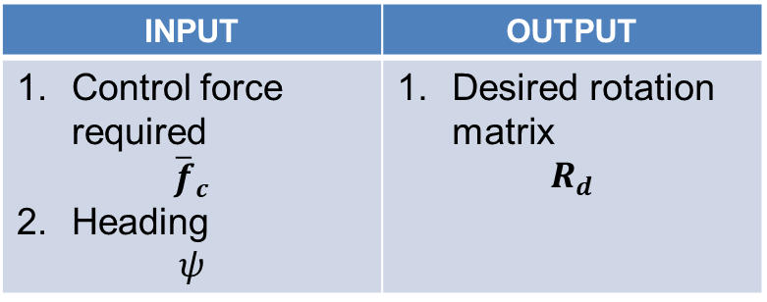
2.1 Control architecture for position-heading tracking control
Position Controller
Allocation
INPUT | OUTPUT
Desired trajectory $$p_{d},v_{d},a_{d}$$ Current state $$p, v$$ | Control force required $${\overline{f}}_{c}$$
INPUT | OUTPUT
Desired forces and moments in body reference $${\overline{f}}_{c},τ_{c}$$ | $Ω$ commanded for each propeller
Attitude Planner
Attitude Controller
INPUT | OUTPUT
Control force required $${\overline{f}}_{c}$$ Heading $$ψ$$ | Desired rotation matrix $$R_{d}$$
INPUT | OUTPUT
Actual and desired rot. matrix $$R_{d}, R$$ 2. Body rotational velocity $ω_{b}$ | Desired control moments $$τ_{c}$$

Slide 9
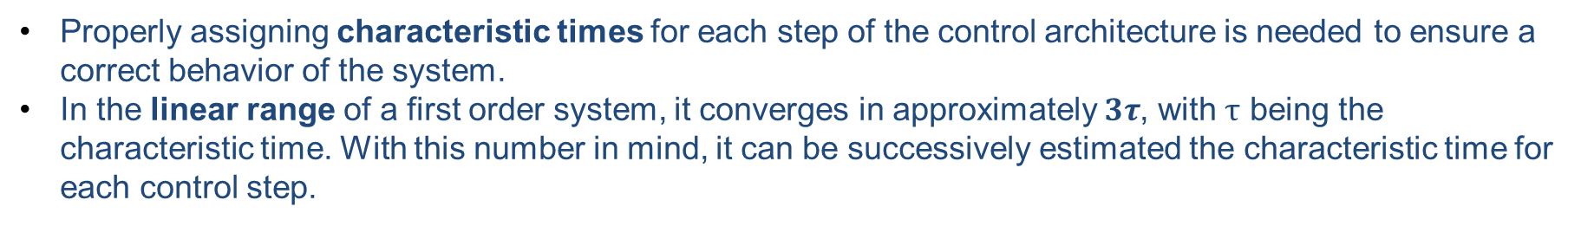
2.1 Control architecture for position-heading tracking control Time scales separation
Properly assigning characteristic times for each step of the control architecture is needed to ensure a correct behavior of the system.
In the linear range of a first order system, it converges in approximately $3τ$, with $τ$ being the characteristic time. With this number in mind, it can be successively estimated the characteristic time for each control step.
Position Controller
Allocation
Attitude Control
$$τ_{att} ≈3{−5 τ}_{act}$$
$$τ_{att}≈ 0.2 s$$
Attitude Control
𝜏_𝑎𝑡𝑡 ≈3〖−5 𝜏〗_𝑎𝑐𝑡
𝜏_𝑎tt≈ 0.2 s
Velocity Control
$$τ_{vel} ≈3−{5 τ}_{att}$$
$$τ_{vel}≈ 0.6 s$$
Velocity Control
𝜏_vel ≈3−〖5 𝜏〗_𝑎tt
𝜏_vel≈ 0.6 s
Position Control
$$τ_{pos} ≈3−{5 τ}_{vel}$$
$$τ_{pos}≈ 2 s$$
Position Control
𝜏_pos ≈3−〖5 𝜏〗_vel
𝜏_pos≈ 2 s
Actuator Dynamics
$$τ_{act}=0.05s$$
Actuator Dynamics
𝜏_𝑎ct=0.05𝑠

Slide 10
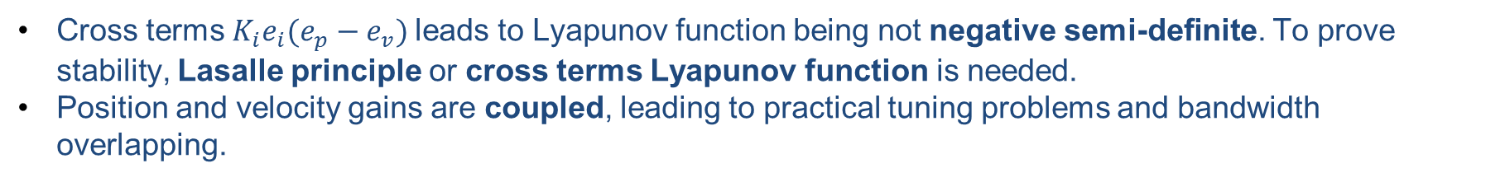




2.1. Control architecture for position-heading tracking control Velocity and position control architecture chosen
Suppose a simplified equation without disturbances:
$$\dot{v}=f_{c}$$
Standard PID or cascade?
$$\dot{v}=f_{c}=−K_{p}e_{p}−K_{v}e_{v}−K_{i}e_{i}$$
$$e_{v}={\dot{e}}_{p};{\dot{e}}_{i}=e_{p}$$
Lyapunov function proposal
$$V=1/2K_{p}e_{p}^{2}+1/2e_{v}^{2}+1/2K_{i}e_{i}^{2}$$
$$\dot{V}=K_{p}e_{p}e_{v}+e_{v}{\dot{e}}_{v}+K_{i}e_{i}e_{p}=−K_{v}e_{v}^{2}+K_{i}e_{i}(e_{p}−e_{v})$$
Cross terms $K_{i}e_{i}(e_{p}−e_{v})$leads to Lyapunov function being not negative semi-definite. To prove stability, Lasalle principle or cross terms Lyapunov function is needed.
Position and velocity gains are coupled, leading to practical tuning problems and bandwidth overlapping.

Slide 11






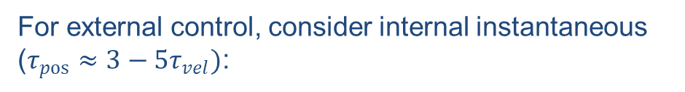
2.1. Control architecture for position-heading tracking control Velocity and position control architecture chosen
Suppose a simplified equation without disturbances:
$$\dot{v}=f_{c}$$
Standard PID or cascade?
$$f_{c}=−K_{vel}\left(v−v_{cmd}\right)−K_{i}ξ$$
Internal
$$v_{cmd}=K_{pos}\left(p_{cmd}−p\right)$$
External
$$V_{int}=1/2{\hat{v}}^{2}+1/2K_{i}ξ^{2}$$
$$\dot{ξ}=\left(v−v_{cmd}\right)=\hat{v}$$
$${\dot{V}}_{int}=−K_{vel}{\hat{v}}^{2}<0$$
Asymptotically Stable
For external control, consider internal instantaneous ($τ_{pos}≈3−5τ_{vel})$:
Both internal and external loops asymptotically stable. Easier tunning, no cross dependence.
$$V_{ext}=1/2e_{p}^{2}→{\dot{V}}_{ext}=e_{p}{\dot{e}}_{p}=−K_{pos}e_{p}^{2}<0$$
Asymptotically Stable

Slide 12
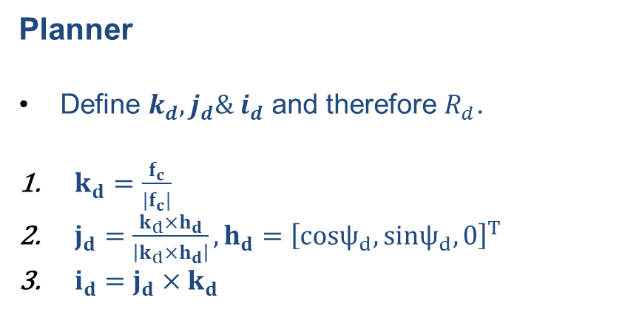

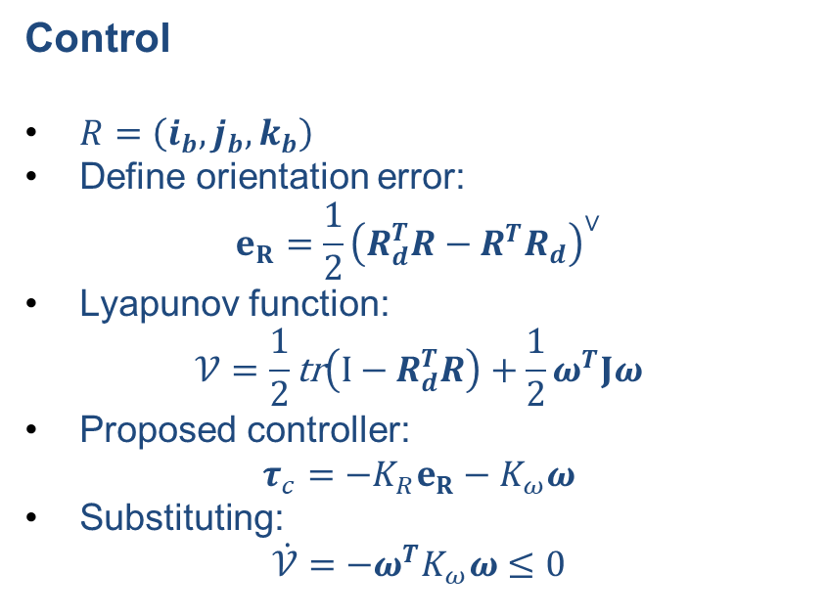

2.1. Control architecture for position-heading tracking control Attitude Planner and Control
$$J\dot{ω}=τ_{c}$$
Planner
Define $k_{d},j_{d}\& i_{d}$ and therefore $R_{d}$.
$k_{d}=\frac{f_{c}}{|f_{c}|}$
$j_{d}=\frac{k_{d}×h_{d}}{\left|k_{d}×h_{d}\right|}, h_{d}={\left[cosψ_{d},sinψ_{d},0\right]}^{T}$
$i_{d}=j_{d}×k_{d}$
Control
$R=\left(i_{b},j_{b},k_{b}\right)$
Define orientation error:
$$e_{R}=\frac{1}{2}{\left(R_{d}^{T}R−R^{T}R_{d}\right)}^{∨}$$
Lyapunov function:
$$𝒱=\frac{1}{2}\text{tr}\left(I−R_{d}^{T}R\right)+\frac{1}{2}ω^{T}Jω$$
Proposed controller:
$$τ_{c}=−K_{R}e_{R}−K_{ω}ω$$
Substituting:
$$\dot{𝒱}=−ω^{T}K_{ω}ω≤0$$
$$R_{d}=(i_{d},j_{d},k_{d})$$
Lyapunov stable, Almost Globally Asymptotically Stable

Slide 13
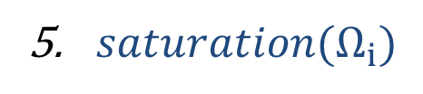

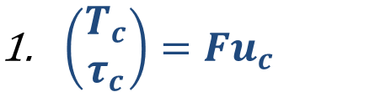


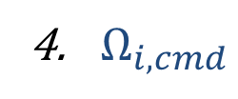


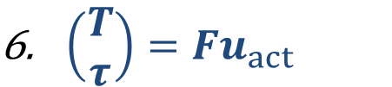


2.1. Control architecture for position-heading tracking control Allocation
F SVD decomposition
$$M=UΣV^{T}$$
$\left(\begin{matrix}T_{c} \\ τ_{c}\end{matrix}\right)=Fu_{c}$
-0.408 | -0.408 | -0.408 | -0.408 | -0.408 | -0.408
0.000 | -0.500 | -0.500 | 0.000 | 0.500 | 0.500
-0.577 | -0.289 | 0.289 | 0.577 | 0.289 | -0.289
-0.408 | 0.408 | -0.408 | 0.408 | -0.408 | 0.408
-0.533 | 0.459 | 0.074 | -0.533 | 0.459 | 0.074
0.222 | 0.350 | -0.573 | 0.222 | 0.350 | -0.573
Vertical
Roll
$V^{T}=$
Pitch
$u_{c}={\left[T_{1,cmd} … T_{N_{r},cmd}\right]}^{⊤}$
Yaw
Null space
$T_{i,cmd}=k_{f}Ω_{i, cmd}^{2}$
2.449 | 0.000 | 0.000 | 0.000 | 0.000 | 0.000
0.000 | 0.372 | 0.000 | 0.000 | 0.000 | 0.000
0.000 | 0.000 | 0.372 | 0.000 | 0.000 | 0.000
0.000 | 0.000 | 0.000 | 0.220 | 0.000 | 0.000
0.000 | 0.000 | 0.000 | 0.000 | 0.000 | 0.000
0.000 | 0.000 | 0.000 | 0.000 | 0.000 | 0.000
Actuator Dynamics
$Ω_{i,cmd}$
$$Ω_{i}$$
$$Σ=$$
$saturation(Ω_{i})$
$$T_{1,act}$$
$\left(\begin{matrix}T \\ τ\end{matrix}\right)=Fu_{act}$
0.000 | 0.000 | 0.000 | 0.000 | -0.899 | -0.437
0.000 | 0.000 | 0.000 | 0.000 | -0.437 | 0.899
-1.000 | 0.000 | 0.000 | 0.000 | 0.000 | 0.000
0.000 | -1.000 | 0.000 | 0.000 | 0.000 | 0.000
0.000 | 0.000 | 1.000 | 0.000 | 0.000 | 0.000
0.000 | 0.000 | 0.000 | 1.000 | 0.000 | 0.000
$$U=$$

Slide 14

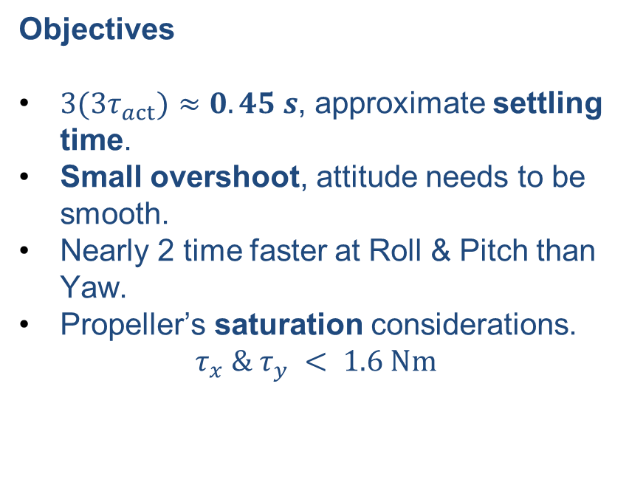



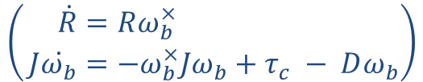

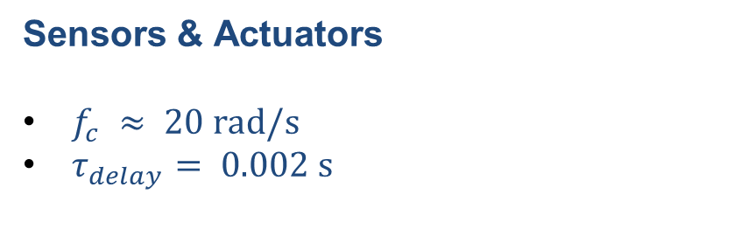
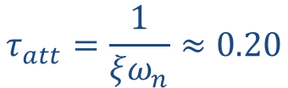
2.2. Control architecture for position-heading tracking control Attitude Controller Tuning – Roll & Pitch
Simplified Attitude Model
$$\begin{aligned}\left(\begin{aligned} \dot{R}&=Rω_{b}^{×} \\ J\dot{ω_{b}}&=−ω_{b}^{×}Jω_{b}+τ_{c} − Dω_{b}\end{aligned}\right)\end{aligned}$$
Objectives
${3(3τ}_{act})≈0.45 s$, approximate settling time.
Small overshoot, attitude needs to be smooth.
Nearly 2 time faster at Roll & Pitch than Yaw.
Propeller’s saturation considerations.
$$τ_{x} \& τ_{y} < 1.6 Nm$$
For simplicity, small angular velocity and small angles are considered, leading to:
$$\ddot{Θ}+\frac{D_{x}+K_{vx}}{J_{xx}}\dot{Θ}+\frac{K_{rx}}{J_{xx}}Θ=0$$
$$K_{rx}≈J_{xx}ω_{n}^{2}$$
$$τ_{att}=\frac{1}{ξω_{n}}≈0.20$$
$$K_{vx}≈2J_{xx}ξω_{n}$$
$$(ω_{n}≈ 6.3 rad/s)$$
Sensors & Actuators
$f_{c} ≈ 20 rad/s$
$τ_{delay}= 0.002 s$
$$ξ_{des}= 0.8$$
Simulated as first
order system
Overshoot of 0.15%
Settling time of 0.45 s

Slide 15
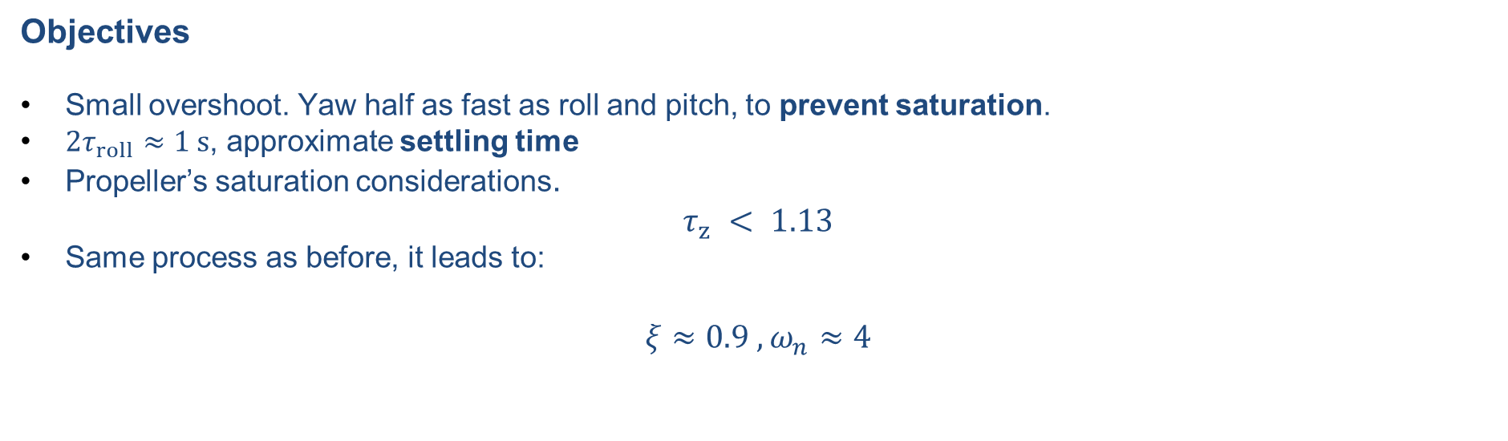
2.2. Control architecture for position-heading tracking control Attitude Controller Tuning - Yaw
Objectives
Small overshoot. Yaw half as fast as roll and pitch, to prevent saturation.
${2τ}_{roll}≈1 s$, approximate settling time
Propeller’s saturation considerations.
$$τ_{z} < 1.13$$
Same process as before, it leads to:
$$ξ≈0.9 ,ω_{n}≈4$$

Slide 16
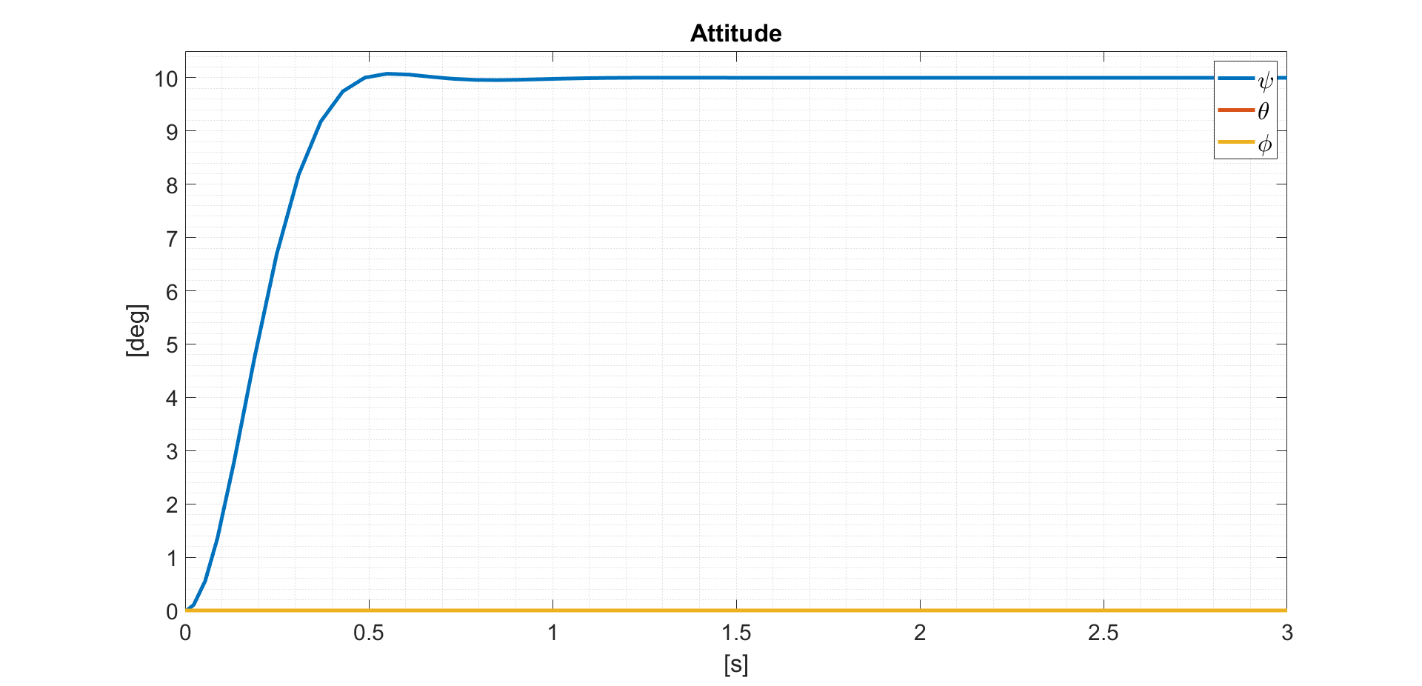
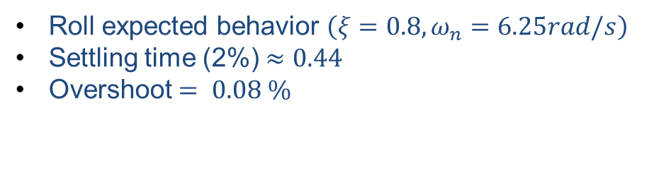
2.2. Control architecture for position-heading tracking control Roll & Pitch attitude control behavior – simplified model
Roll expected behavior $\left(ξ=0.8,ω_{n}=6.25rad/s\right)$
Settling time (2%) $≈0.44$
Overshoot $= 0.08 \%$

Slide 17
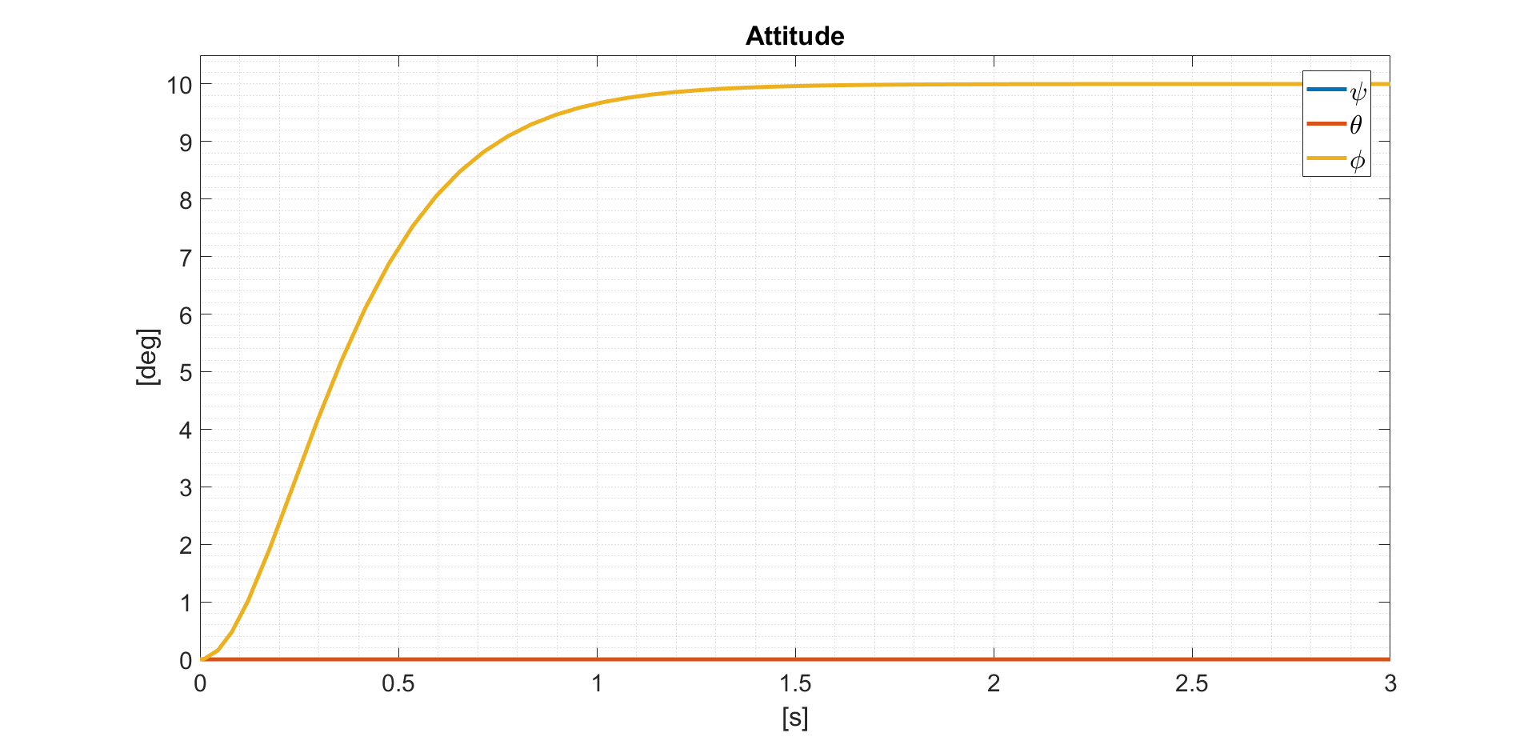
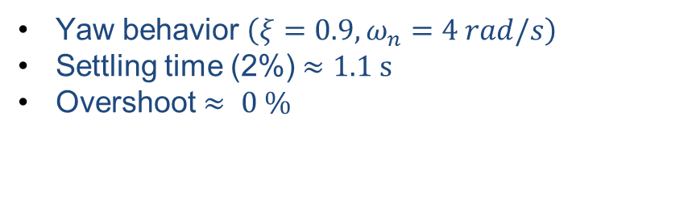
2.2. Control architecture for position-heading tracking control Yaw attitude control behavior – simplified model
Yaw behavior $\left(ξ=0.9,ω_{n}=4 rad/s\right)$
Settling time (2%) $≈1.1 s$
Overshoot $≈ 0 \%$

Slide 18
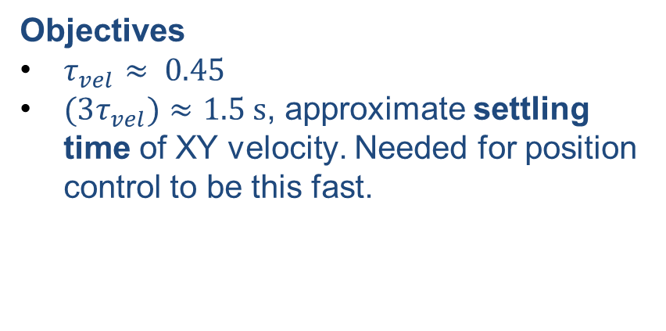

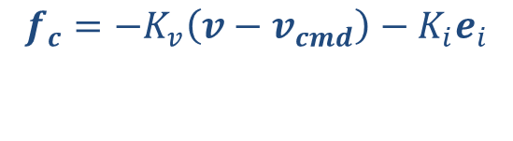



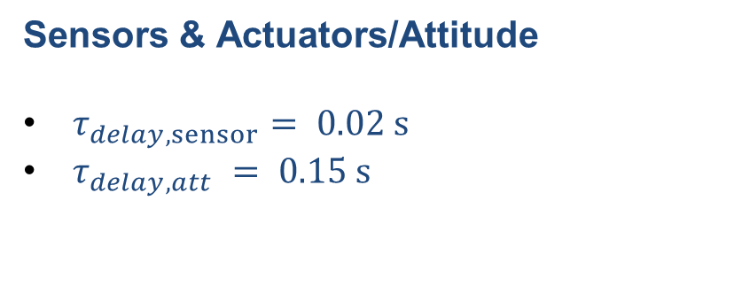

2.2. Control architecture for position-heading tracking control Velocity Control – X & Y
Simplified Attitude Model
$$\dot{v}=−Dv/m−g+f_{c}/m$$
Objectives
$τ_{vel}≈ 0.45$
$(3τ_{vel})≈1.5 s$, approximate settling time of XY velocity. Needed for position control to be this fast.
$$f_{c}=−K_{v}\left(v−v_{cmd}\right)−K_{i}e_{i}$$
$${\dot{e}}_{i}=\left(v−v_{cmd}\right)$$
$$\ddot{v}+\frac{D+K_{v}}{m}\dot{v}+\frac{K_{i}}{m}v=\frac{K_{i}}{m}v_{cmd}$$
$$ω_{n}≈1 rad/s$$
$K_{i}≈mω_{n}^{2}$
Sensors & Actuators/Attitude
$τ_{delay,sensor}= 0.02 s$
$τ_{delay,att} = 0.15 s$
$K_{v}≈m2ξω_{n}$
$$ξ≈1$$
Simulated as first
order system

Slide 19
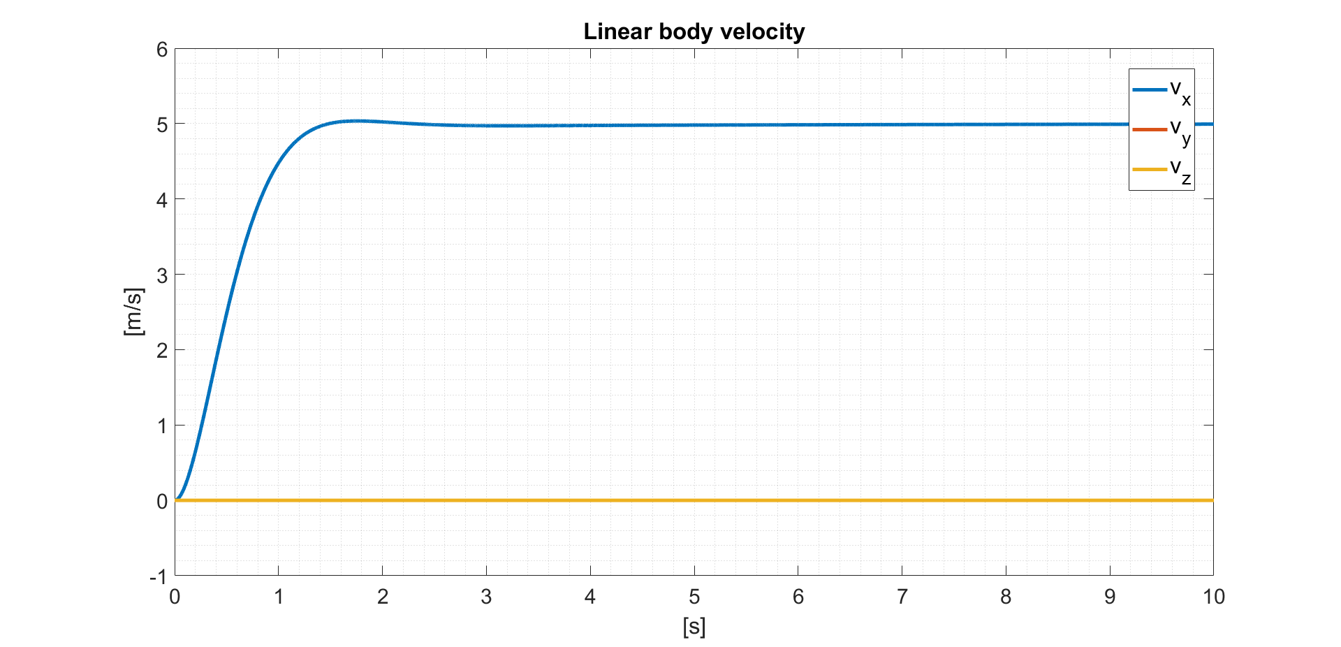
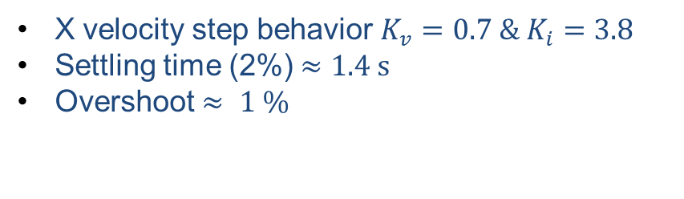
2.1. Control architecture for position-heading tracking control Velocity Control step response - XY
X velocity step behavior $K_{v}=0.7 \& K_{i}=3.8$
Settling time (2%) $≈1.4 s$
Overshoot $≈ 1 \%$

Slide 20

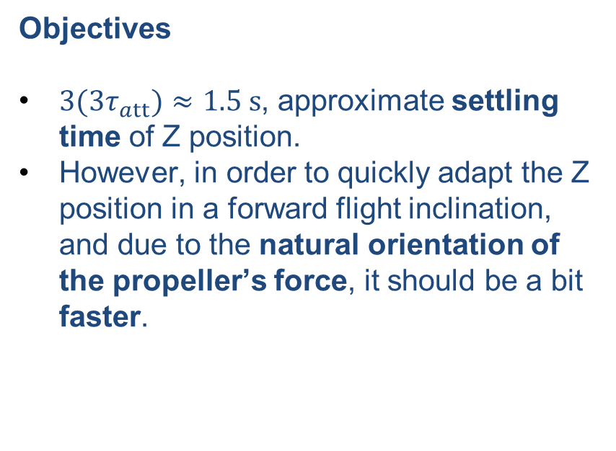

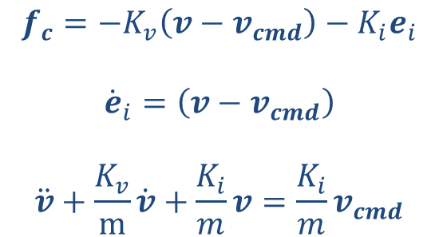


2.2. Control architecture for position-heading tracking control Velocity Control – Z
Simplified Attitude Model
Objectives
${3(3τ}_{att})≈1.5 s$, approximate settling time of Z position.
However, in order to quickly adapt the Z position in a forward flight inclination, and due to the natural orientation of the propeller’s force, it should be a bit faster.
$$\dot{v}=−g+f_{c}/m$$
$$f_{c}=−K_{v}\left(v−v_{cmd}\right)−K_{i}e_{i}$$
$${\dot{e}}_{i}=\left(v−v_{cmd}\right)$$
$$\ddot{v}+\frac{K_{v}}{m}\dot{v}+\frac{K_{i}}{m}v=\frac{K_{i}}{m}v_{cmd}$$
If Ki = 0, it results in an integrator (first order system). Without uncertainties in mass or vertical bias perturbations, and with weight feedforward, no need for it.
$$0.38 N <T_{Z}< 25.5 N$$
Sensors & Actuators/Attitude
$τ_{delay,sensor}= 0.02 s$
$τ_{delay,act} = 0.05 s$
$$K_{v}=3;K_{i} = 0$$

Slide 21
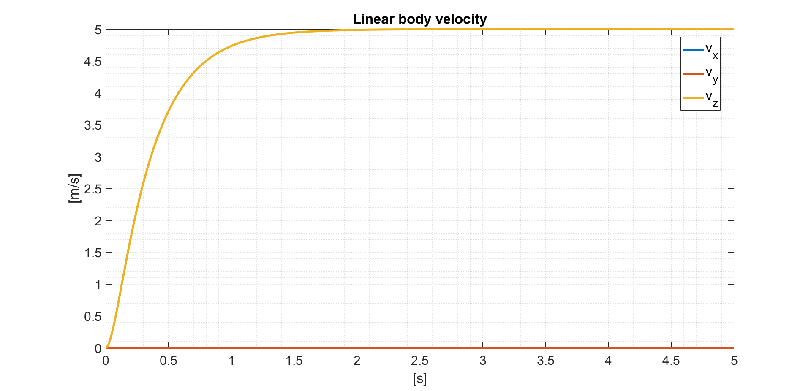
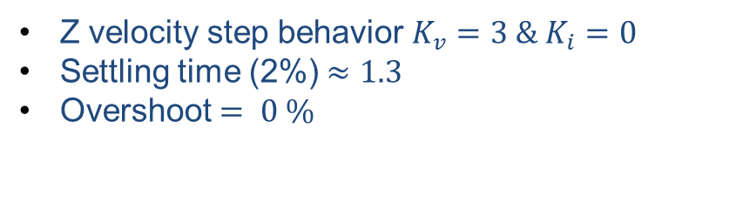
2.1. Control architecture for position-heading tracking control Velocity Control step response - z
Z velocity step behavior $K_{v}=3 \& K_{i}=0$
Settling time (2%) $≈1.3$
Overshoot $= 0 \%$

Slide 22
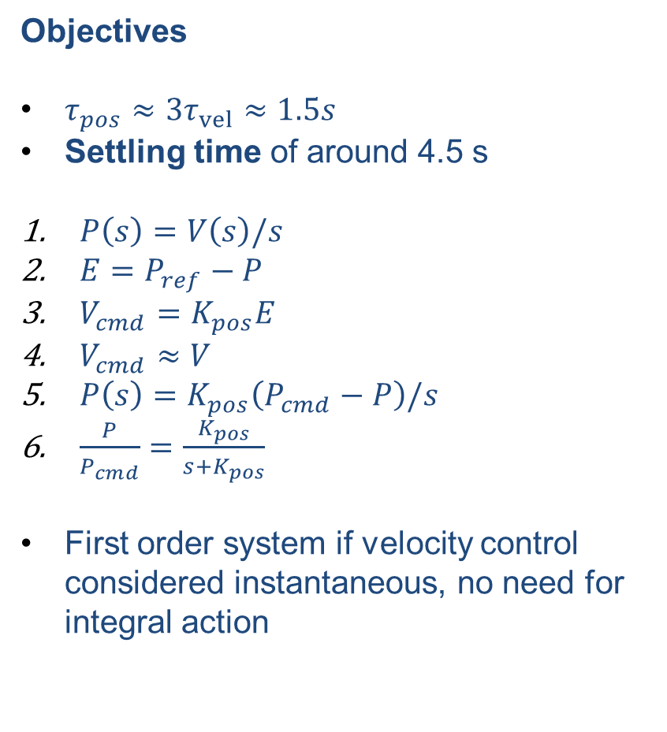
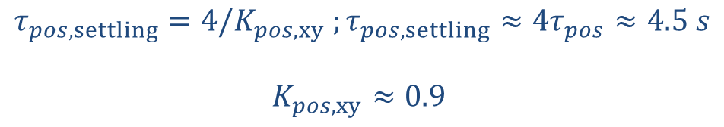
2.2. Control architecture for position-heading tracking control Position Control
Objectives
$τ_{pos}≈{3τ}_{vel}≈1.5s$
Settling time of around 4.5 s
$P\left(s\right)=V\left(s\right)/s$
$E=P_{ref}−P$
$V_{cmd}=K_{pos}E$
$V_{cmd}≈V$
$P\left(s\right)=K_{pos}\left(P_{cmd}−P\right)/s$
$\frac{P}{P_{cmd}}=\frac{K_{pos}}{s+K_{pos}}$
First order system if velocity control considered instantaneous, no need for integral action
$$τ_{pos,settling}=4/K_{pos,xy} ;τ_{pos,settling}≈4τ_{pos}≈4.5 s$$
$$K_{pos,xy}≈0.9$$
For Z, same with slightly smaller settling time, due to propellers orientation and gravity help.
$$K_{pos,z}≈1$$

Slide 23
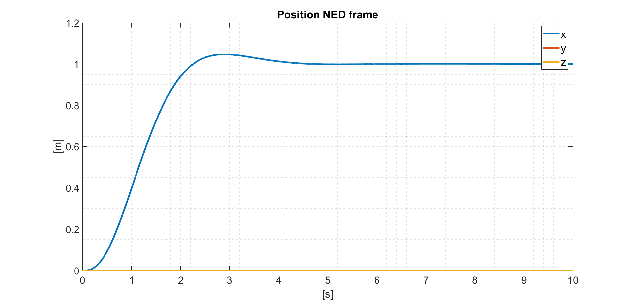
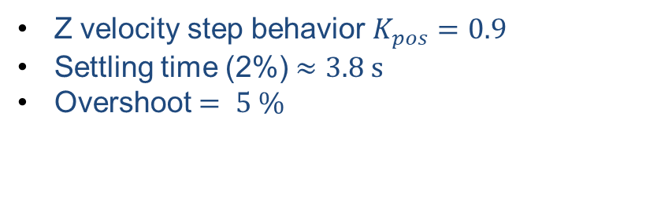
2.1. Control architecture for position-heading tracking control Position Control step response - XY
Z velocity step behavior $K_{pos}=0.9$
Settling time (2%) $≈3.8 s$
Overshoot $= 5 \%$

Slide 24
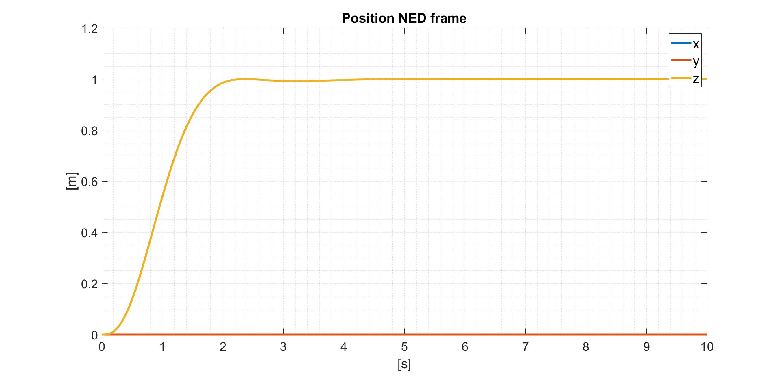
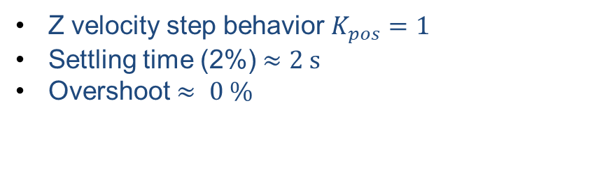
2.1. Control architecture for position-heading tracking control Position Control step response - Z
Z velocity step behavior $K_{pos}=1$
Settling time (2%) $≈2 s$
Overshoot $≈ 0 \%$

Slide 25
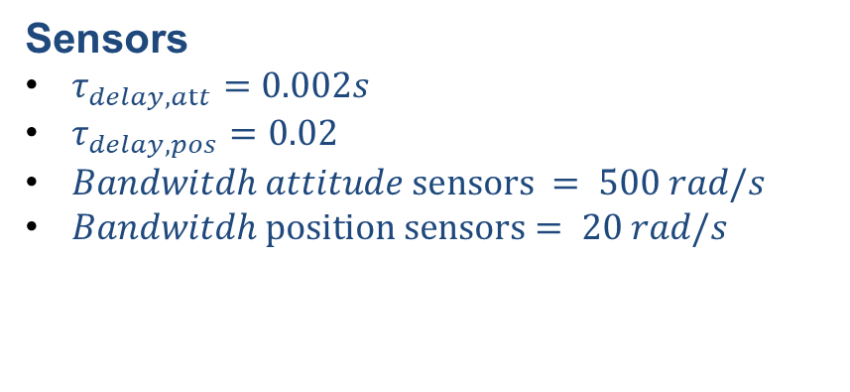
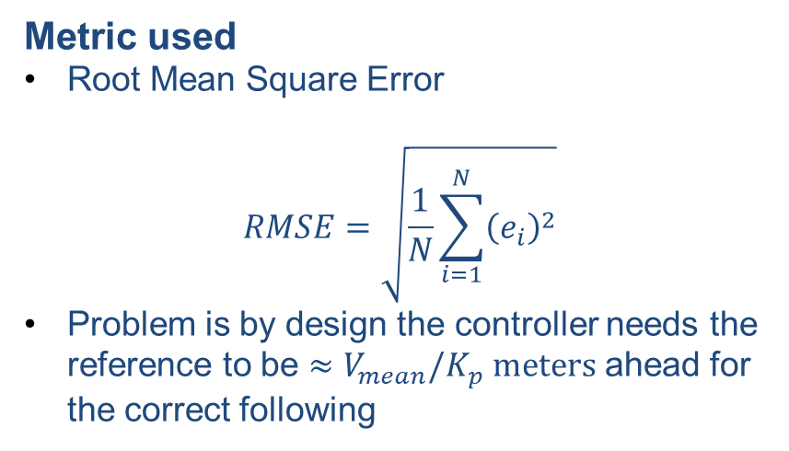
2.3. Control architecture for position-heading tracking control Full model test
Tests
Simple XY & Z position step
8 shape
Simple trajectory
V max = 5 m/s
Metric used
Root Mean Square Error
$$RMSE=\sqrt{\frac{1}{N}\sum_{i=1}^{N}{{\left(e_{i}\right)}^{2}}}$$
Problem is by design the controller needs the reference to be $≈V_{mean}/K_{p} meters$ ahead for the correct following
Sensors
$τ_{delay,att}=0.002s$
$τ_{delay,pos}=0.02$
$Bandwitdh attitude sensors = 500 rad/s$
$Bandwitdh position sensors= 20 rad/s$

Slide 26
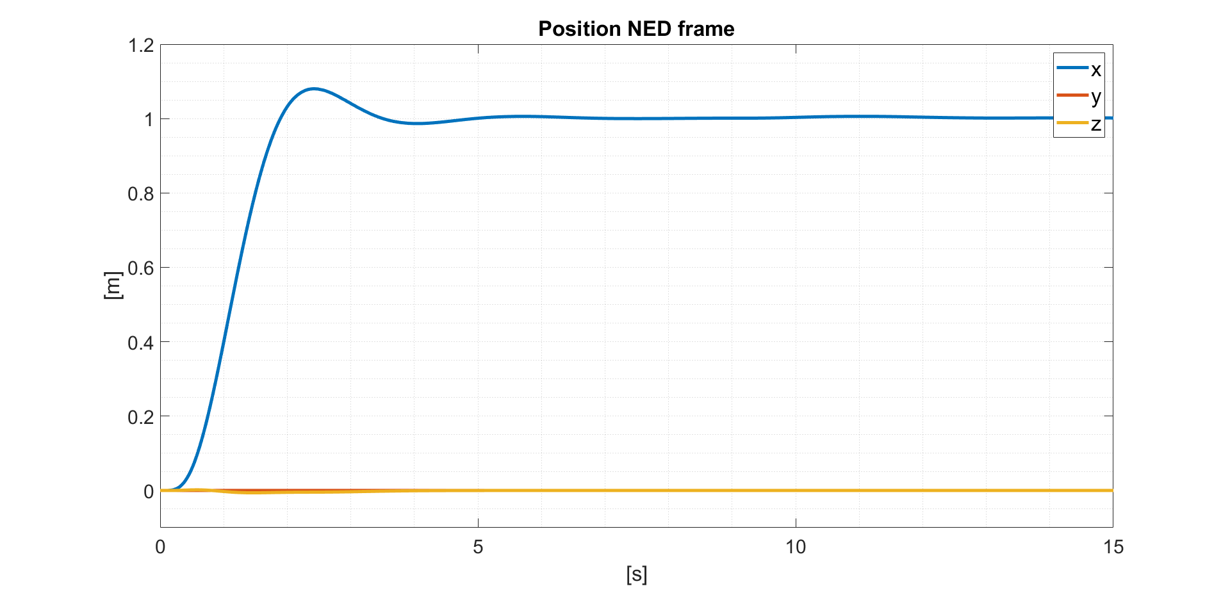
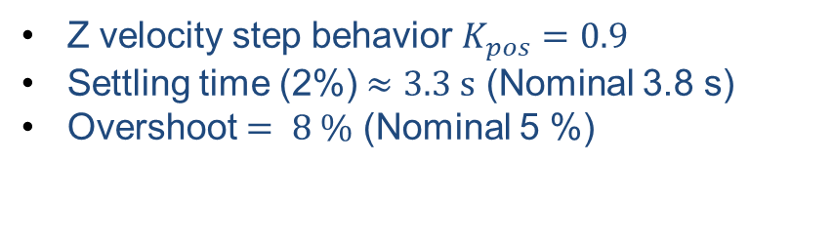
2.1. Control architecture for position-heading tracking control Step response full model - XY
Z velocity step behavior $K_{pos}=0.9$
Settling time (2%) $≈3.3 s$ (Nominal 3.8 s)
Overshoot $= 8 \%$ (Nominal 5 %)
*Z fall of <1cm

Slide 27


2.1. Control architecture for position-heading tracking control Step response full model - Z
Z velocity step behavior $K_{pos}=1$
Settling time (2%) $≈2.1 s$ (Nominal 2 s)
Overshoot $≈ 1 \%$ (Nominal 0 %)

Slide 28



2.3. Control architecture for position-heading tracking control Full model test – 8 Shape
Reference trajectory
X width = 10 meters
Y width = 10 meters
$ω$ = 0.20 rad/s
$$V_{mean}≈3 m/s$$
$ΔV ≈ 1.5 m/s$
$$RSME = 4 m$$

Slide 29


2.3. Control architecture for position-heading tracking control Full model test – 8 Shape
Propeller’s effectiveness reduction
A reduction of a 20% of effectiveness of one propeller at the first right turn of the 8 shape.
$$RSME = 3.9 m$$

Slide 30



2.3. Control architecture for position-heading tracking control Full model test – trajectory
Reference trajectory
2 meters ascend
X displacement of 8 meters
Turn on Y (R=2 meters)
3 meters straight
2 meters descend
$$V_{mean}≈1.5 m/s$$
$$RSME = 1 m$$
$$T_{t}=14 s$$

Slide 31


2.3. Control architecture for position-heading tracking control Full model test – trajectory
Propeller’s effectiveness reduction
A reduction of a 20% of effectiveness of one propeller after the initial vertical ascent.
Failure leads to error on Y tracking of 1 meter and a velocity lost that leads to continuous error that deteriorates the path.
$$RSME = 1.3 m$$
$$T_{t} = 14 s$$

Slide 32


2.3. Control architecture for position-heading tracking control Full model test – trajectory
Propeller’s effectiveness reduction
A reduction of a 20% of effectiveness of one propeller after the initial vertical ascent.
Reference configured to not get ahead some distance of the UAV to improve its behavior while doubling time taken to finish the path.
$$RSME = 1.1 m$$
$$T_{t} = 30 s$$

Slide 33
3. Adaptive Augmentation

Slide 34





3.1. Adaptive Augmentation Package definition
$${UAV.r}_{c}∈ [0.04, 0.06] m$$
EQUATIONS MODIFICATIONS
CG
$UAV.m=UAV.m_{0}+UAV.m_{p}$
$J_{p,CG}=UAV.m_{p}∗UAV.r_{c}^{2}$
$J=J+\left[100;010;000\right]J_{p,CG}$
${UAV.m}_{p}∈[0, 1]$ kg
UAV New Behavior
$K_{i,z}$ in the Z position controller was set null in the nominal design due to complete knowledge of the UAV mass. In order to correct the Z bias due to the package, activation of this term is needed. $K_{i,xy}$ is taken as reference.
$J$ change is around 10% of total in XY rotations, not such a big change for not aggressive maneuvers.
$K_{i,z} = 2$, converges to 5%
In 10 seconds. High values
worsen transitory.

Slide 35



3.1. Adaptive Augmentation Package definition – Z position control update
Z velocity step behavior $K_{I}=0$
Settling time (2%) $≈2.1 s$
Overshoot $≈ 1 \%$
Z velocity step behavior $K_{I}=2$
Settling time (2%) $≈4.7 s$
Overshoot $≈ 2 \%$
Undershoot $≈ 6 \%$

Slide 36



3.1. Adaptive Augmentation Package definition - Tracking
Trajectory tracking with package
Due to increase in $K_{i,z}$, trajectory
tracking is reasonably good, but Z position error peaks initially around -1 meters and any vertical commands has light error due to change in Z controller.
$$RSME = 1.1 m$$
$$T_{t} = 14 s$$

Slide 37


3.2. PBMRAC Reason and Objectives
Controller + Weight Feedforward
$$f_{c}=f\left(e_{p}\right)$$
Plant
Slow convergence, need for integral action to achieve equilibrium, with limitations in its value due to transient requirements.
P, V
Predictor
V
With the initial estimation of the parameters, the predictor compares the internal simulation results (with the baseline controller as input) with the real state of the UAV, updates the values of the estimations and ads a controller force that complements the baseline one to vanish the predictor error.
Does not need to know the structure of the baseline controller and can be unplugged if necessary.
Controller + Weight Feedforward
Plant
$$f_{c,bl }=f\left(e_{p}\right)$$
P,V

Slide 38






3.2. PBMRAC Equations
Parameter uncertainties
$UAV.m$
$D$
Bias (Wind)
$Λ_{f}$
Plant equations
Predictor
$${\dot{v}}_{p}=A_{p}v_{p}+B_{p}\left(Λu+φ{\left(x_{p}\right)}^{⊤}θ_{p}\right)−L\hat{e}$$
$$m\dot{v_{i}}=−mge_{3}+f_{e}+Λ_{f}f_{c}$$
$$f_{e}=−D\left(v−v_{wind}\right)$$
$${\dot{v}}_{p}=A_{p}v_{p}+B_{p}\left(φ_{a}{ \left(x_{p}, u\right)}^{⊤}θ_{a}\right)−L\hat{e}$$
$A_{p} \& B_{p}$known, all uncertainties (constant) in $Θ_{a}$ and their regressor in $φ_{a}$. Term $L\hat{e}$ works on predictor and UAV dynamics to converge.
$$A_{p} = 0$$
$${ B}_{p}=1/\overline{m}$$
$$φ_{a}^{T}=\left(\begin{matrix}u_{x} & 0 & 0 & 1 & 0 & 0 & −v_{1} & 0 & 0 \\ 0 & u_{y} & 0 & 0 & 1 & 0 & 0 & {−v}_{2} & 0 \\ 0 & 0 & u_{z} & 0 & 0 & −1 & 0 & 0 & {−v}_{3}\end{matrix}\right)$$
$$θ^{T} = [Λ_{x}/m,Λ_{y}/m,Λ_{z}/m,θ_{x},θ_{y} ,\overline{m}g ,\overline{m}{/mD}_{x},\overline{m}/mD_{y},\overline{m}/mD_{z}];$$

Slide 39






3.2. PBMRAC Equations
Predictor error dynamic
$${\dot{\hat{e}}}_{p}={\dot{v}}_{p}−{\dot{\hat{v}}}_{p}=B_{p}\left(\underset{ΔΛ}{\underbrace{\left(Λ−\hat{Λ}\right)}}u+φ_{p}{\left(x_{p}\right)}^{⊤} \underset{Δθ}{\underbrace{\left(θ−\hat{θ}\right)}}\right)−L\hat{e}$$
$${\dot{\hat{e}}}_{p}=B_{p}\left(φ_{a}{\left(x_{p}, u\right)}^{⊤} {Δθ}_{a}\right)−L\hat{e}$$
Lyapunov function proposed ($Γ_{a} >0$) :
$$V\left(\hat{e},Δθ_{a}\right)≔\frac{1}{2}{\left|\hat{e}\right|}^{2}+\frac{1}{2}Δθ_{a}^{⊤}Γ_{a}Δθ_{a}$$
$$ℒ_{𝒻}V=−{\hat{e}}^{T}L\hat{e}+Δθ_{a}^{⊤}\left(φ_{a}\left(u,x_{p}\right)B_{p}^{⊤}\hat{e}−Γ_{a}^{−1}\dot{{\hat{θ}}_{a}}\right)$$
For Lie Derivative of V to be negative semidefinite, the parenthesis needs to be null:
$${\dot{\hat{θ}}}_{a}=Γ_{a}φ_{a}\left(u,x_{p}\right)B_{p}^{⊤}\hat{e}$$
Gain update law to assure $\hat{e}→0$

Slide 40


3.2. PBMRAC Equations
Adaptive input $u_{a}$
$$u=u_{b}+u_{a}$$
$$u_{a}=\left({\hat{Λ}}^{−1}−I\right)u_{b}−{\hat{Λ}}^{−1}φ_{p}{\left(x_{p}\right)}^{⊤}{\hat{θ}}_{p} → u={\hat{Λ}}^{−1}\left(u_{b}−φ_{p}{\left(x_{p}\right)}^{⊤}{\hat{θ}}_{p} \right)$$
$${\dot{\hat{v}}}_{p}=A_{p}v_{p}+B_{p}\left(\hat{Λ}\left({\hat{Λ}}^{−1}u_{b}−φ_{p}{\left(x_{p}\right)}^{⊤}{\hat{θ}}_{p}\right)+φ_{p}{\left(x_{p}\right)}^{⊤}{\hat{θ}}_{p}\right)+L\hat{e} = A_{p}v_{p}+B_{p}u_{b}+L\hat{e}$$
For $\hat{e} →0$, predictor behavior is identical to the plant
Why no attitude augmentation?
Expected modification of attitude parameters is not as high as the position ones. However, the presence of expected bias in the behavior , i.e. a displacement in XY plane of the CG position, makes impossible for the baseline attitude controller to converge to the desired orientation due to lack of integral action, so it would be needed to model the attitude uncertainties in the predictor.

Slide 41
3.2. PBMRAC Projector + e modification
Projector
e-modification
Operator in the adaptive laws that avoids drift of the gains, bounding them in a predefined space and while keeping the Lie Derivative of Lyapunov function negative semidefinite.
Modification to the adaptive laws that provides damping, slowing down the evolution of the gains.

Slide 42

3.2. PBMRAC Static desired position test
Mass uncertainty
Assuming maximum package weight (1 kg).

Slide 43


3.2. PBMRAC Trajectory Test
Mass uncertainty + Propeller efficiency reduction
Mass uncertainty is matched in less than 3 seconds, with an initial descent of less than 20 centimeters (0.16 kg of $Δm$). Small package enough to avoid saturation.
After a transient with an overshoot of 2 meters, the UAV converges in around 5 seconds and recovers trajectory tracking performance.

Slide 44


3.2. PBMRAC Trajectory Test
Adaptive ON
Adaptive OFF
Wind of -5 m/s Y at end of ascend
Mass uncertainty not considered.
A smaller overshoot and good convergence of the behavior just before the right turn

Slide 45
4. Test delivery scenario

Slide 46


4. Test delivery scenario Map & Trajectory
Trajectory around buildings of characteristic length 10 meters. Start in 2.5 meters height, with ascension to 5 meters and package delivery in 7.5 meters.
Total length $≈ 60 m$, reference achieves it in 22 seconds (around 2.7 m/s mean velocity).
For the test, two considerations of unforeseen events:
Crosswind in –Y direction, intensified in the crossroads.
Degradation of 10 % of all propellers’ forces.

Slide 47


4. Test delivery scenario Base Trajectory tracking
30 s
40 s
Mean distance of 1.4 meters between reference and UAV, with peaks of 9 meters in the straight (RMSE of 4.5 m).
Fulfilment of the trajectory in 30 seconds (2 m/s mean velocity).
For 40 seconds (slower reference), RMSE is 3.6 meters, with peaks of 6 meters in the straight.

Slide 48


4. Test delivery scenario Trajectory tracking with wind
*To avoid saturation, a windspeed of 5 m/s (1 Newton force) has been considered in crossroads and 1 m/s in the rest.

Slide 49

4. Test delivery scenario Trajectory tracking with wind & propeller effectiveness reduction
Reduction of all propellers’ effectiveness in t = 0.
Overshoot in lambda estimation leads to overshoot in height, but fast convergence leads to no lateral displacement that could cause a collision of the UAV with surroundings.

Slide 50
Thanks for your attention

